Slide 1

HOTEL VRINDAVAN SEVA SADAN
(THAKUR SHREE RADHA BIHARI CHARITABLE TRUST)
RADHA MOHANVAN, CHHATTIKARA MARG, RAMAN RETI,
SHRI DHAM VRINDAVAN(UP)
Group No.19
Under The Supervision of:-
DR.VINOD JAIN
(ASSITANT PROFESSOR)
DEPARTMENT OF CEA
GLA UNIVERSITY, MATHURA
Presented By:-
PRASHANT DEV UPADHYAY(174200109)
PRASHANT SHARMA(174200111)
PRATISHTHA DWIVEDI(174200113)
PRERNA SHARMA(174200114)
PUSHPENDRA SINGH(174200119)

Slide 2
Content
Introduction
Problem Statement
Objective
Functions
Hardware And Software Requirement
Project Scope
Tools and Technology
Data Flow Diagram
ER-Diagram
Screenshots
Conclusion
References

Slide 3
Introduction
•Hotel VRINDAVAN SEVA SADAN (THAKUR SHREE RADHA BIHARI CHARITABLE TRUST) RADHA MOHANVAN, CHHATTIKARA MARG, RAMAN RETI, SHRI DHAM VRINDAVAN(UP) is a hotel management website which provide people seeking hotel rooms with accurate information about available accommodations.
•It provides all the information related to the hotel. It is very helpful for the customers who don’t have time and book their rooms last minute.
•User can view room inventory, check availability and book rooms.
•It also allow booking of rooms without errors and without creating conflicts.

Slide 4
Problem Statement
Difficulty in location of guests files
Large storage space
Poorly generated records
Complaints from guests
Poor communication
Difficulty in data analysis

Slide 5
Objective
The objectives of the system are-
To make it easy for customers to book rooms.
To enable automated data entry methods.
Avoid data entry errors by use of input masks.
Enforce security measures to avoid unauthorized access to guest records.
Enable fast and easy retrieval of guest records and data for fast reference activities.

Slide 6
Functions
•Room status.
•New Customer Admission.
•Details of the Customer Check in and Check out.
•Allocation of Room as per the Customer Interest.
•Transactions of the Customer.

Slide 7
Hardware And Software Specification
Processor : Intel Dual Core or More
Processor Speed : 1.5 GHZ
RAM : 2 GB
Hard Disk : 2 GB of free space
Internet connection : Required
Operating System : Window 7 and higher
Front End : HTML, CSS, Java Script, jQuery, Bootstrap
Back End : SQL Server, PHP
Text Editor : Sublime text, Notepad++, Visual Studio Code.
Server : XAMPP Server (Cross-platform, Apache, MariaDB (MySQL), PHP and Perl)

Slide 8
Project Scope
This system will cover the following sections of the hotel:-
Room
Booking
Login
Food
Transport
Contact

Slide 9
Tools and Technology
Tools:
Windows 7 & and higher
Notepad++
Visual Studio Code
SQL Server
XAMPP Server (Cross-platform, Apache, MariaDB (MySQL), PHP and Perl)
Technology:
HTML5
CSS3
JavaScript
JQuery
Bootstrap4
SQL
PHP

Slide 10
DATA FLOW DAIGRAM LEVEL-0
LOGIN RESPONSE
ENQUIRY
LOGIN
USER
ADMIN
REQUEST
LOGIN
HOTEL
MANAGEMENT SYSTEM
REQUEST FOR
CHECK IN
REQUEST FOR
USER
RESTAURANT SERVICE
INFORMATION
RESPONSE

Slide 11
LEVEL-1
Request for registration
USER
Registration For Employee
Admin & User
Add new user
Provide User ID&Password
1.0
ADMIN
Registration For available room and room details
Registration
Room details
User info
2.0
Sign in
as
Admin
Sign in
As User
Bill
Login
Information
Booking Room
3.0
D3 User database
Room Info management
Check Room Availability
4.0
User Info management
Sign in
As Employee
D2 Room database
Make payment
5.0
Update
User info
Given ID&Password
Payment Successfull
Account management
D1 Employee database
EMPLOYEE

Slide 12
ER DAIGRAM
Email
U_id
Username
Phone no
Password
Number
1
Has
N
User
1
Book
N
Room
Login_Id
Login
Type
Login_
password
1
N
Price
1
Name
Pay
order
1
1
1
N
Has
Bills
Food
Has
Date
Price
Type
N
1
Bill_no.
Discount
Has
tax
Name
N
Ad_id
Can
apply leave
Ac_Name
Admin
1
N
Employee
N
Update
N
Facilities
Name
Password
Password
Phone no.
charges
Email
Emp_id
Emp_name
Email

Slide 13
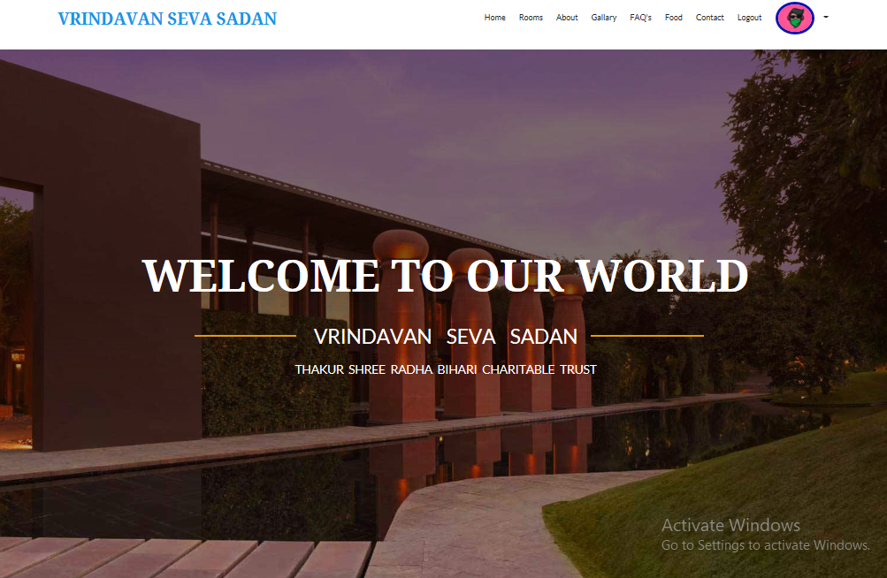
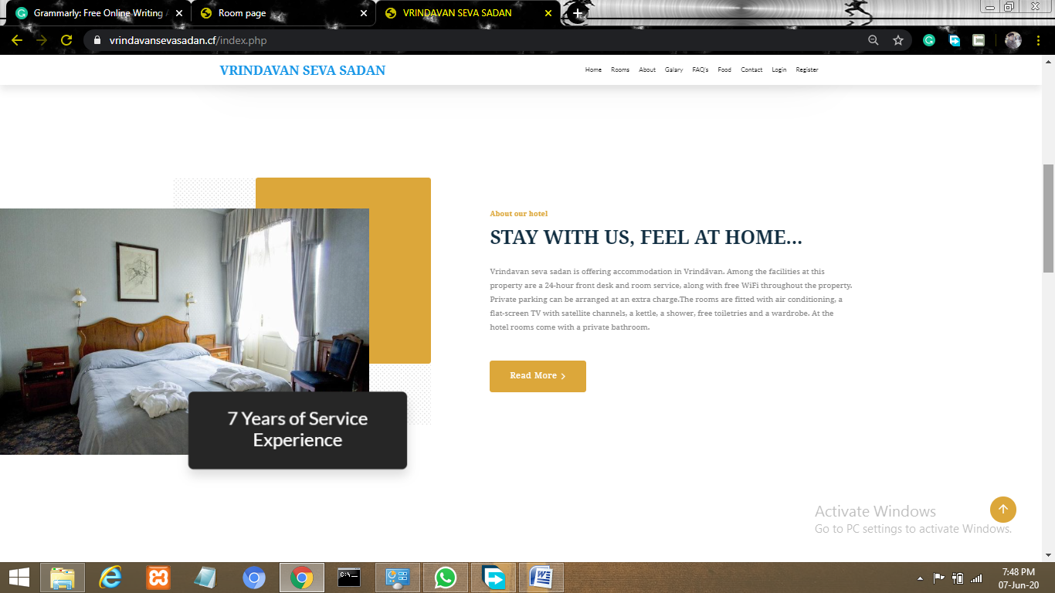
Some ScreenShots

Slide 14
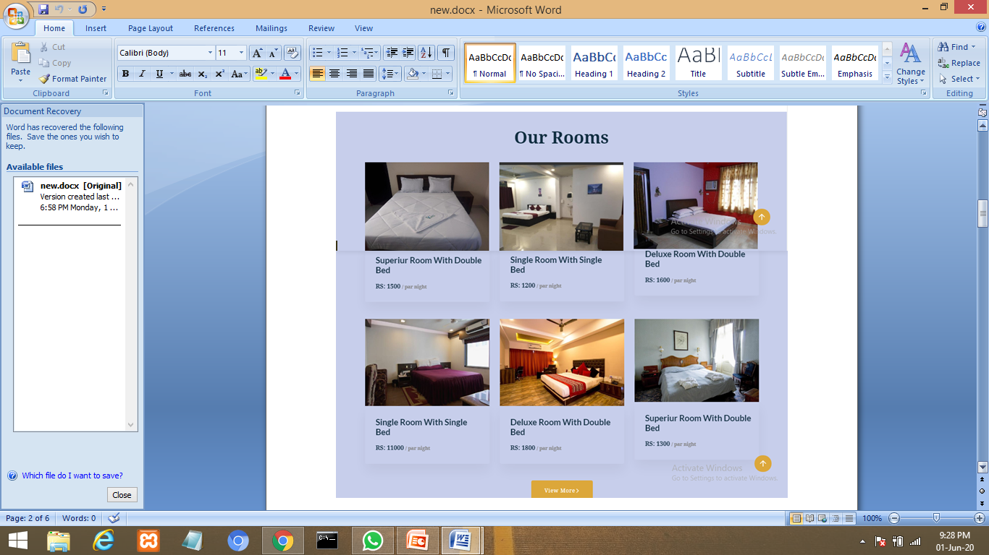

Slide 15
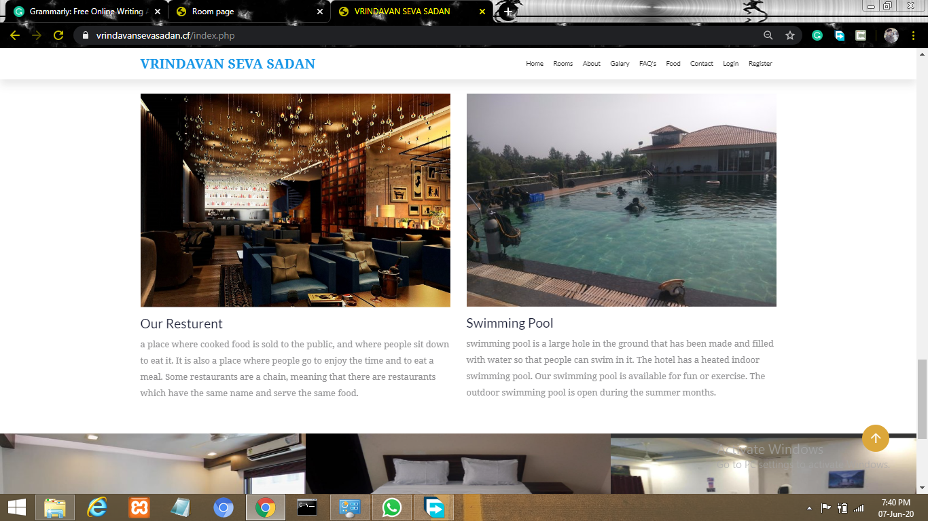

Slide 16
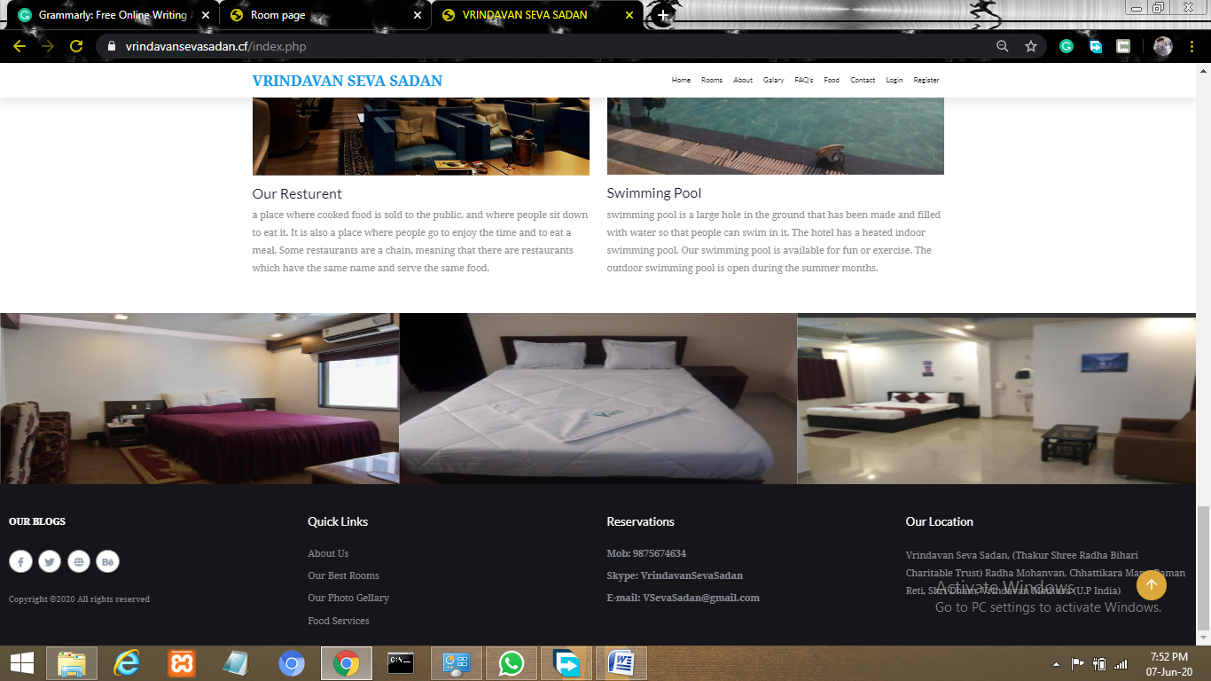

Slide 17
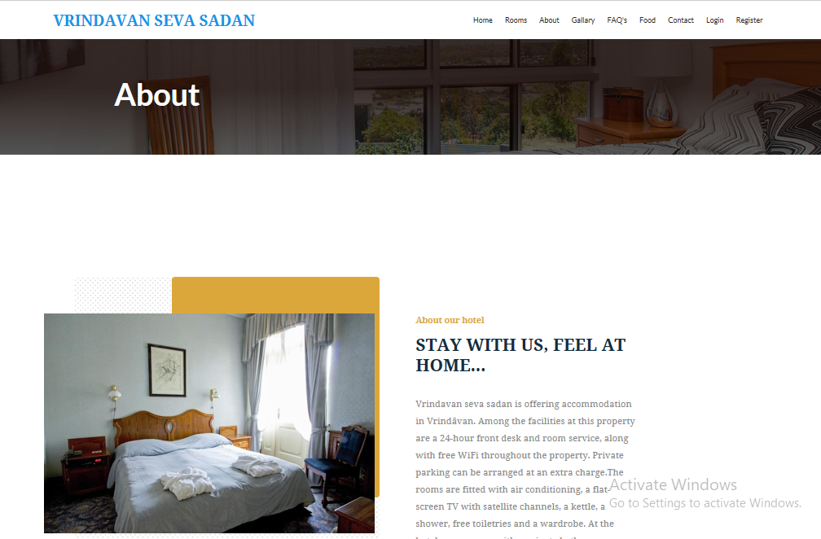
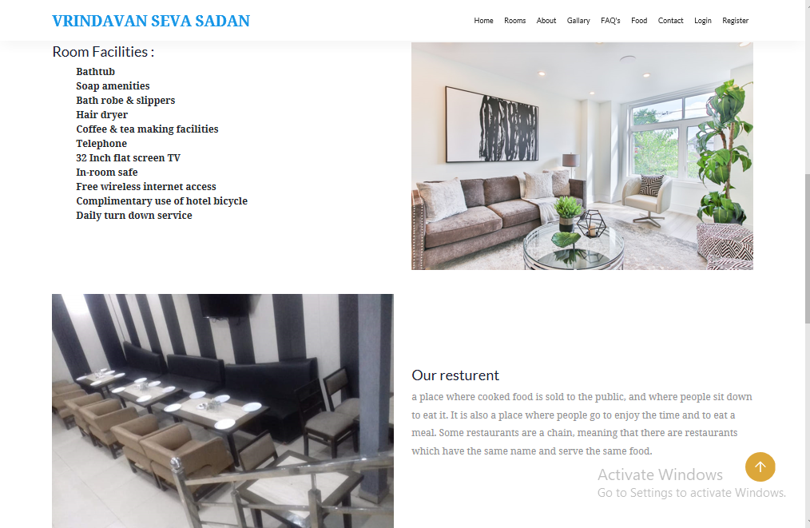

Slide 18
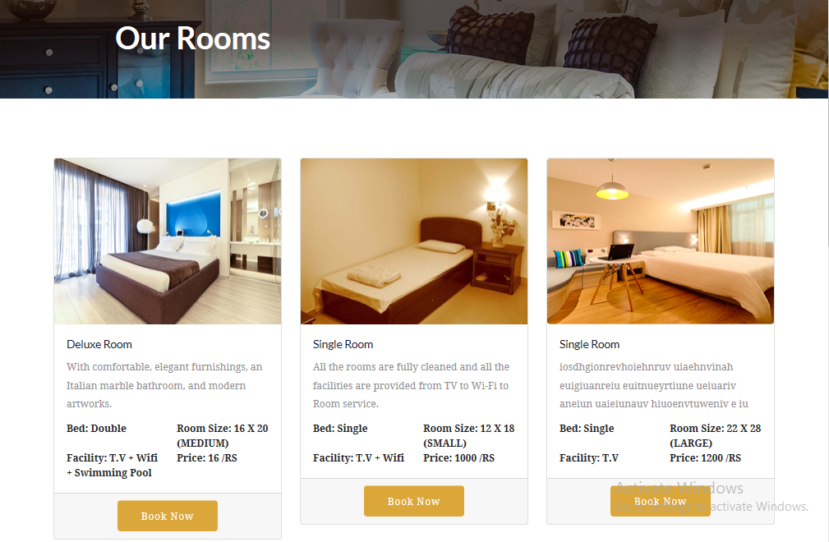
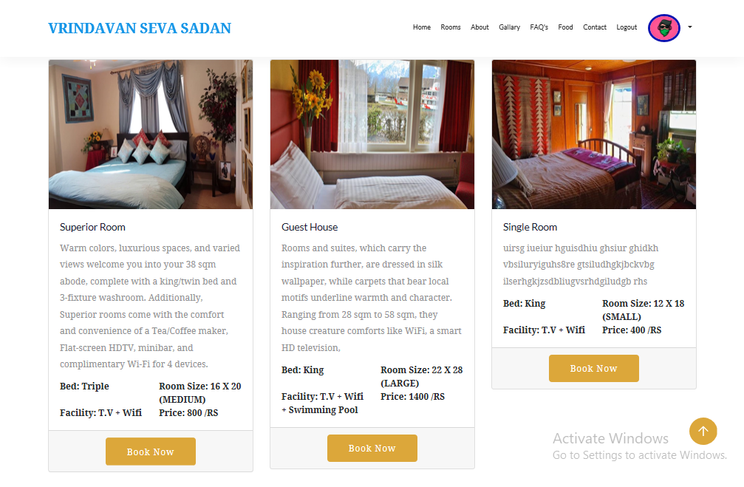

Slide 19
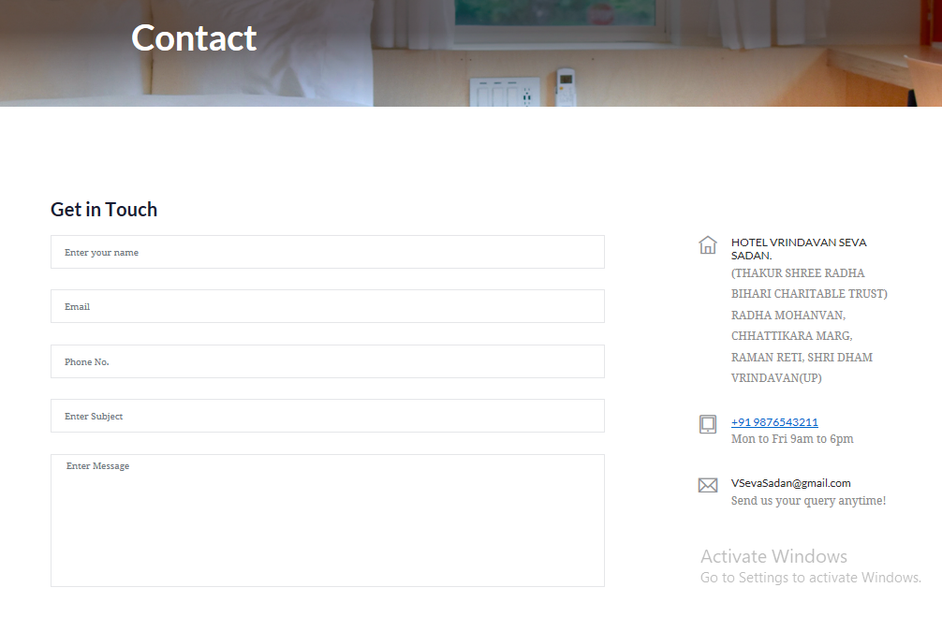
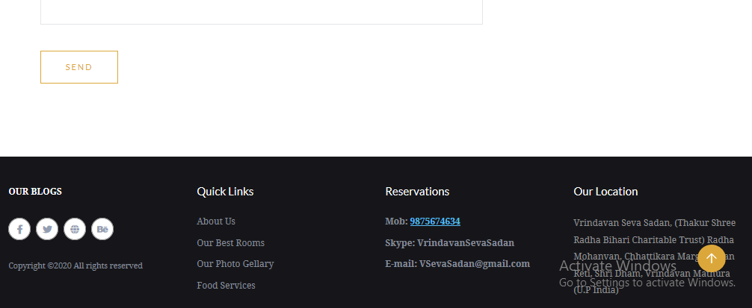

Slide 20
DATABASE TABLES
Attribute | Type | Description | Constraints
ID | Int (255) | ID of admin | Primary Key
Username | varchar (255) | Username of admin | Not Null
Password | Varchar (255) | Password of admin | Not Null
Attribute | Type | Description | Constraints
U_id | Int (255) | ID of user | Primary Key
Name | Varchar (255) | Name of user | Not Null
Username | Varchar (255) | Username of user | Not Null
Phone | Varchar (255) | Phone No. of user | Not Null
Aadhar | Varchar (255) | Unique Aadhar No. | Not Null
Email | Varchar (255) | User email address | Not Null
Password | Varchar (255) | Password of user | Not Null
Role | Varchar (255) | Always user | Not Null
U_img | Varchar (255) | User profile img | Not Null
Table 3.1: Admin Login
Table 3.2: User Login

Slide 21
Attribute | Type | Description | Constraints
Emp_id | Int (255) | Id of emp | Primary Key
Emp_name | Varchar (255) | Name of emp | Not Null
Emp_username | Varchar (255) | Username of emp | Not Null
Emp_phone | Varchar (255) | Phone no. of emp | Not Null
Emp_email | Varchar (255) | Email of emp | Not Null
Emp_address | Varchar (255) | Address of emp | Not Null
Emp_city | Varchar (255) | City of emp | Not Null
Emp_state | Varchar (255) | State of emp | Not Null
Emp_dept | Varchar (255) | Department of emp | Not Null
Emp_doj | Varchar (255) | Date of joining emp | Not Null
Emp_dob | Varchar (255) | Date of birth of emp | Not Null
Emp_password | Varchar (255) | Password of emp | Not Null
Attribute | Type | Description | Constraints
Con_id | Int (255) | id of contact msg | Primary Key
Con_user_name | Varchar (255) | Name of user | Not Null
Con_user_email | Varchar (255) | Email of user | Not null
Con_user_phone | Varchar (255) | Phone of user | Not null
Con_user_sbj | Varchar (255) | Subject of question | Not null
Con_user_msg | Text | Complete message | Not null
Con_msg_date | Varchar (255) | Message date | Not Null
U_id | Int (255) | Id of user | Not Null
Table 3.4: Contact US
Table 3.3: Employee Login

Slide 22
Attribute | Type | Description | Constraints
mess_id | Int (255) | id of message | Primary Key
U_id | Int (255) | Id of user | Not Null
Con_id | Int (255) | Id of contact | Not null
Message | Text | Complete message | Not null
Attribute | Type | Description | Constraints
Room_id | Int(255) | id of leave | Primary Key
Room_number | Varchar (255) | Room number | Not Null
Room_type | Varchar (255) | Type of Room | Not null
Room_bed | Varchar (255) | Bed in the Room | Not null
Room_size | Varchar (255) | Size of Room | Not null
Room_extra | Varchar (255) | Extra facility of Room | Not null
Room_abour | Varchar (255) | Something about Room | Not Null
Room_price | Varchar (255) | Price of Room | Not Null
Room_img | Varchar (255) | Image of Room | Not Null
Table 3.5: Reply Message
Table 3.6: Rooms

Slide 23
Attribute | Type | Description | Constraints
Breakst_id | Int(255) | id of breakfast | Primary Key
Breakst_name | Varchar (255) | Name of breakfast | Not Null
Breakst_size | Varchar (255) | Size of breakfast | Not null
Breakst_price | Varchar (255) | Price of breakfast | Not null
Attribute | Type | Description | Constraints
Lunch_id | Int(255) | id of lunch | Primary Key
Lunch_name | Varchar (255) | Name of lunch | Not Null
Lunch_size | Varchar (255) | Size of lunch | Not null
Lunch_price | Varchar (255) | Price of lunch | Not null
Table 3.7: Breakfast
Table 3.8: Lunck

Slide 24
Attribute | Type | Description | Constraints
Dinner_id | Int(255) | id of dinner | Primary Key
Dinner_name | Varchar (255) | Name of dinner | Not Null
Dinner_size | Varchar (255) | Size of dinner | Not null
Dinner_price | Varchar (255) | Price of dinner | Not null
Attribute | Type | Description | Constraints
Fullmeal_id | Int(255) | id of fullmeal | Primary Key
Fullmeal_name | Varchar (255) | Name of fullmeal | Not Null
Fullmeal_size | Varchar (255) | Size of fullmeal | Not null
Fullmeal_price | Varchar (255) | Price of fullmeal | Not null
Table 3.9: Dinner
Table 3.10: Full meal

Slide 25
Attribute | Type | Description | Constraints
Room_id | Int(255) | Id of Room | Primary Key
Title | Varchar (255) | Title of room | Not Null
User_name | Varchar (255) | Username of user | Not Null
Email | Varchar (255) | Email of user | Not Null
Phone | Varchar (255) | Phone of user | Not Null
State | Varchar (255) | State of user | Not Null
City | Varchar (255) | City of user | Not Null
Cin | Varchar (255) | Check in date | Not Null
Cout | Varchar (255) | Check out date | Not Null
Meal | Varchar (255) | Food meal | Not Null
No. of days | Int (255) | Number of days | Not Null
Attribute | Type | Description | Constraints
Id | Int(255) | id of leave | Primary Key
Emp_id | Int (255) | Id of emp | Not Null
Emp_name | Varchar (255) | Name of emp | Not null
Emp_phone | Varchar (255) | Phone of emp | Not null
Emp_email | Varchar (255) | Email of emp | Not null
Start_date | Varchar (255) | Leave start date | Not null
End_date | Varchar (255) | Leave end date | Not Null
Emp_reason | Varchar (255) | Reason of leave | Not Null
Emp_explain | Text | -
Table 3.11: Employee Leave Application
Table 3.12: Room Bookings

Slide 26
Conclusion
Reduces human efforts
Saves time
Reduces inconvenience
Booking of rooms without errors

Slide 27
References
www.w3schools.com/php.net
www.stackoverflow.com
www.php.net-tutorial.com
www.w3schools.com/css

Slide 28
THANK YOU!!!

